Slide 1

Visual Reality
&
Social Media
Haebenn Choi, Yenan Lin, Chieko Tazuke, Jingwen Yang

Slide 2
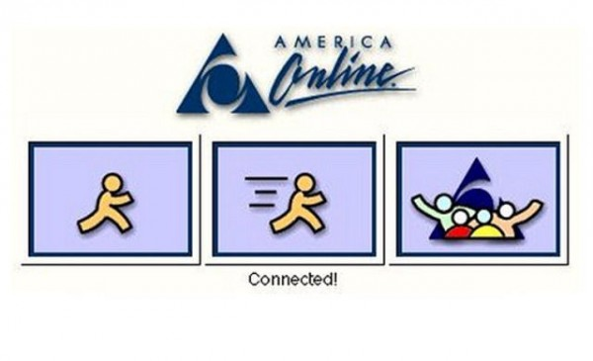

Chieko edited on Dec 2
Social Media - how people are connected
Human beings have explored the ways of long distance communication over centuries. In 1990s, people were connected by e-mails by sending long text messages. This interaction built close, strong ties among them.
Now many people use facebook as a platform of communication. We can send short text messages, images and videos immediately without any cost. As we can contact with people very easily and instantly, each bond becomes weaker.
1990s
2010s
VS
Long texts
Strong ties
Personal
Short texts, images, videos
Weak ties
Public
http://blog.scienceborealis.ca/youve-got-mail-and-everything-else-whats-a-science-blogger-to-do/
http://marketingland.com/library/channel/social-media-marketing

Slide 3
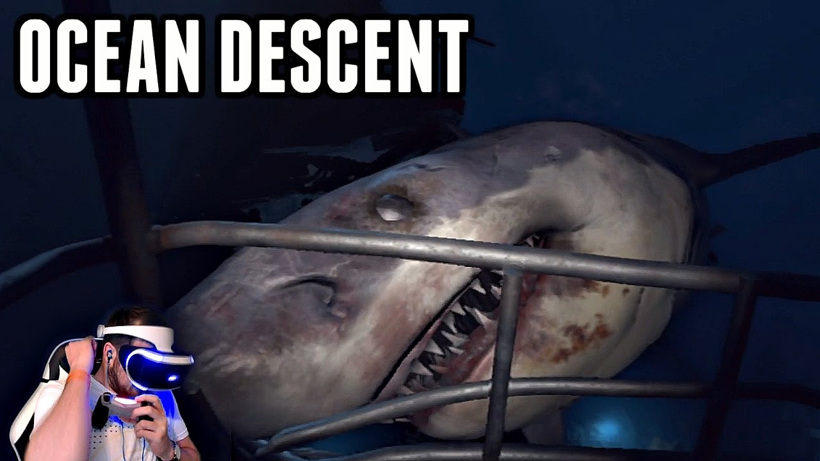
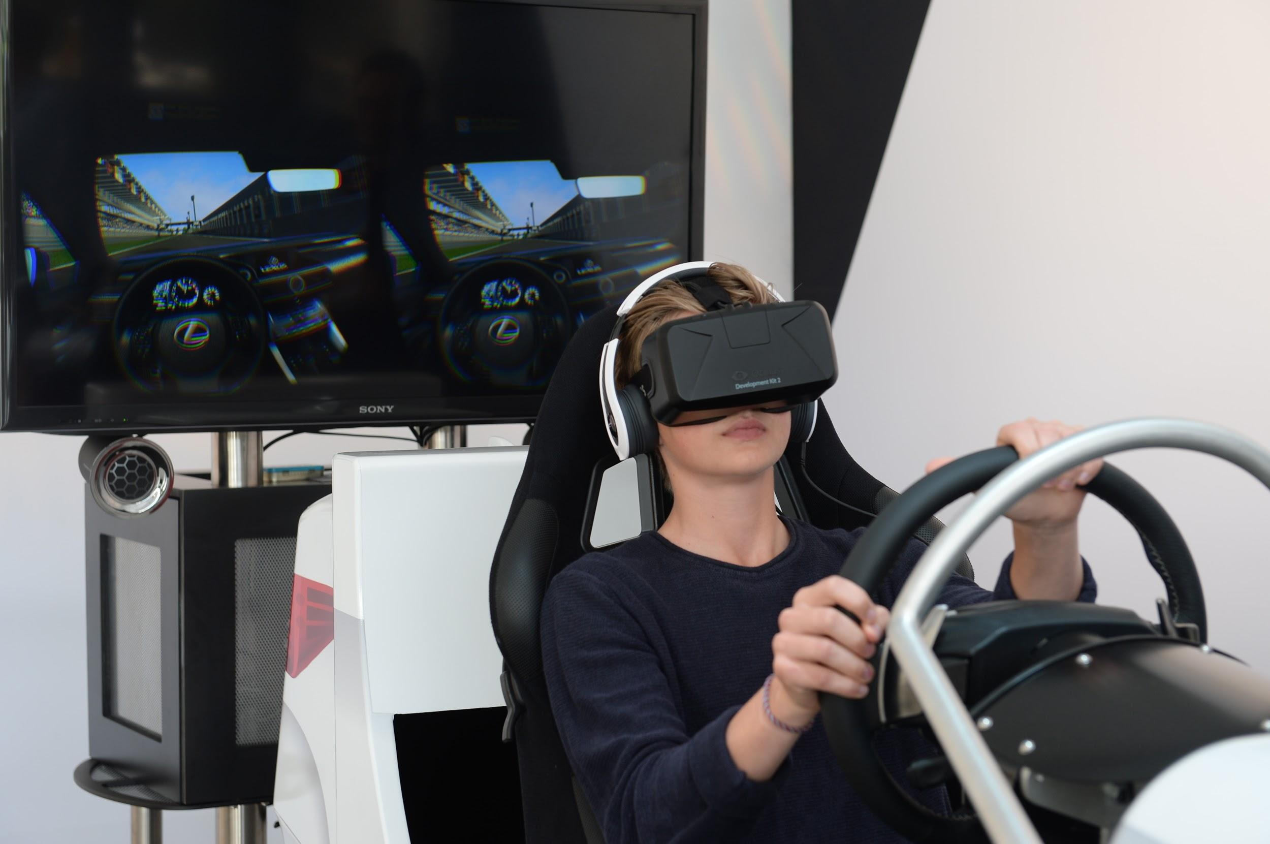
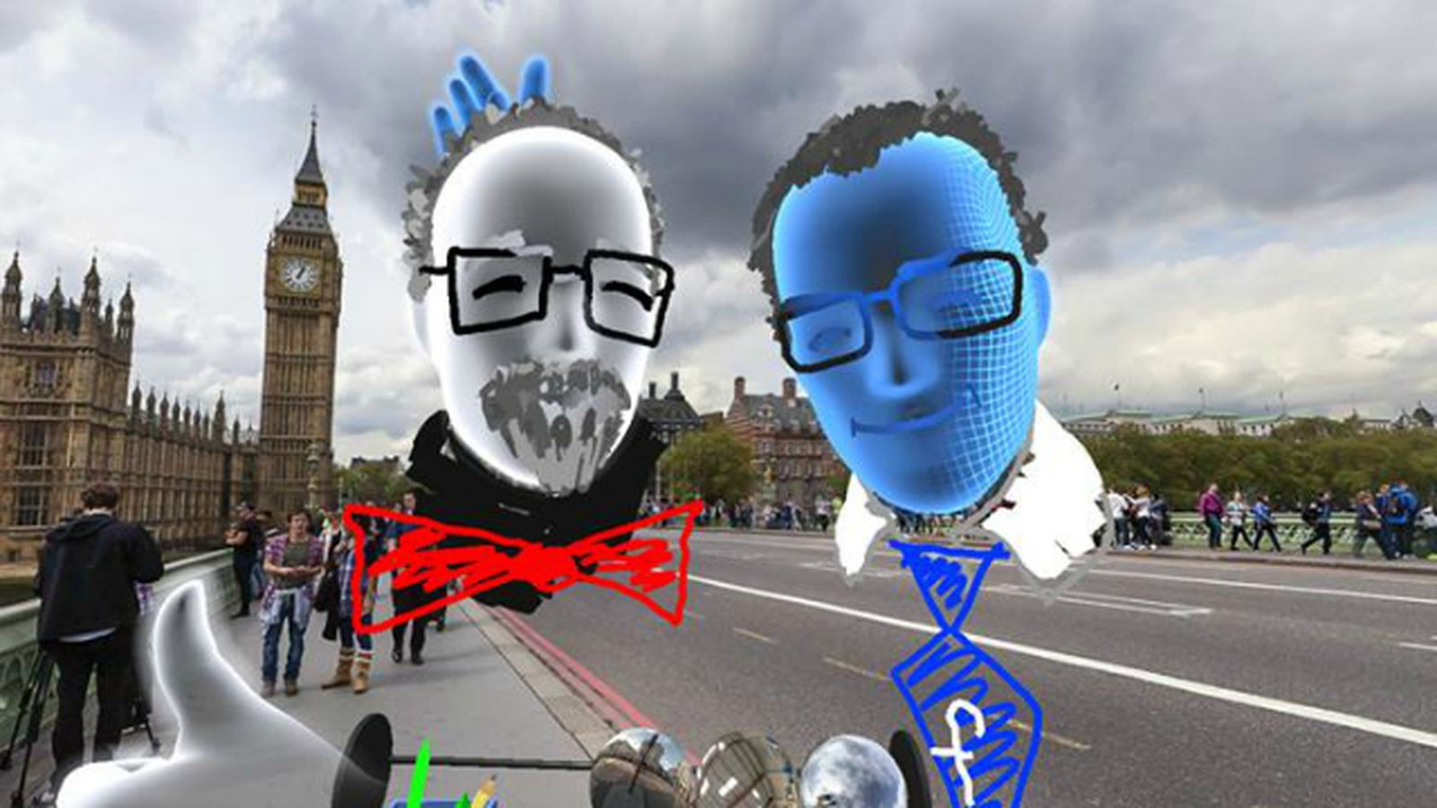
Chieko edited on Dec 2
VR - how people feel real environment
Game
Simulation
Social VR
VR is a technology that we can experience real environment in a cyber space. It is originally developed in gaming and simulation areas, but we think there is a possibility to strengthen our connection between individuals.
https://www.youtube.com/watch?v=ggNvYqHKeaQ
http://venturebeat.com/2014/10/01/a-true-virtual-showroom-lexus-and-oculus-rift-show-the-potential-sales-power-of-vr/
http://www.recode.net/2016/4/13/11586098/watch-facebook-social-virtual-reality-demo

Slide 4
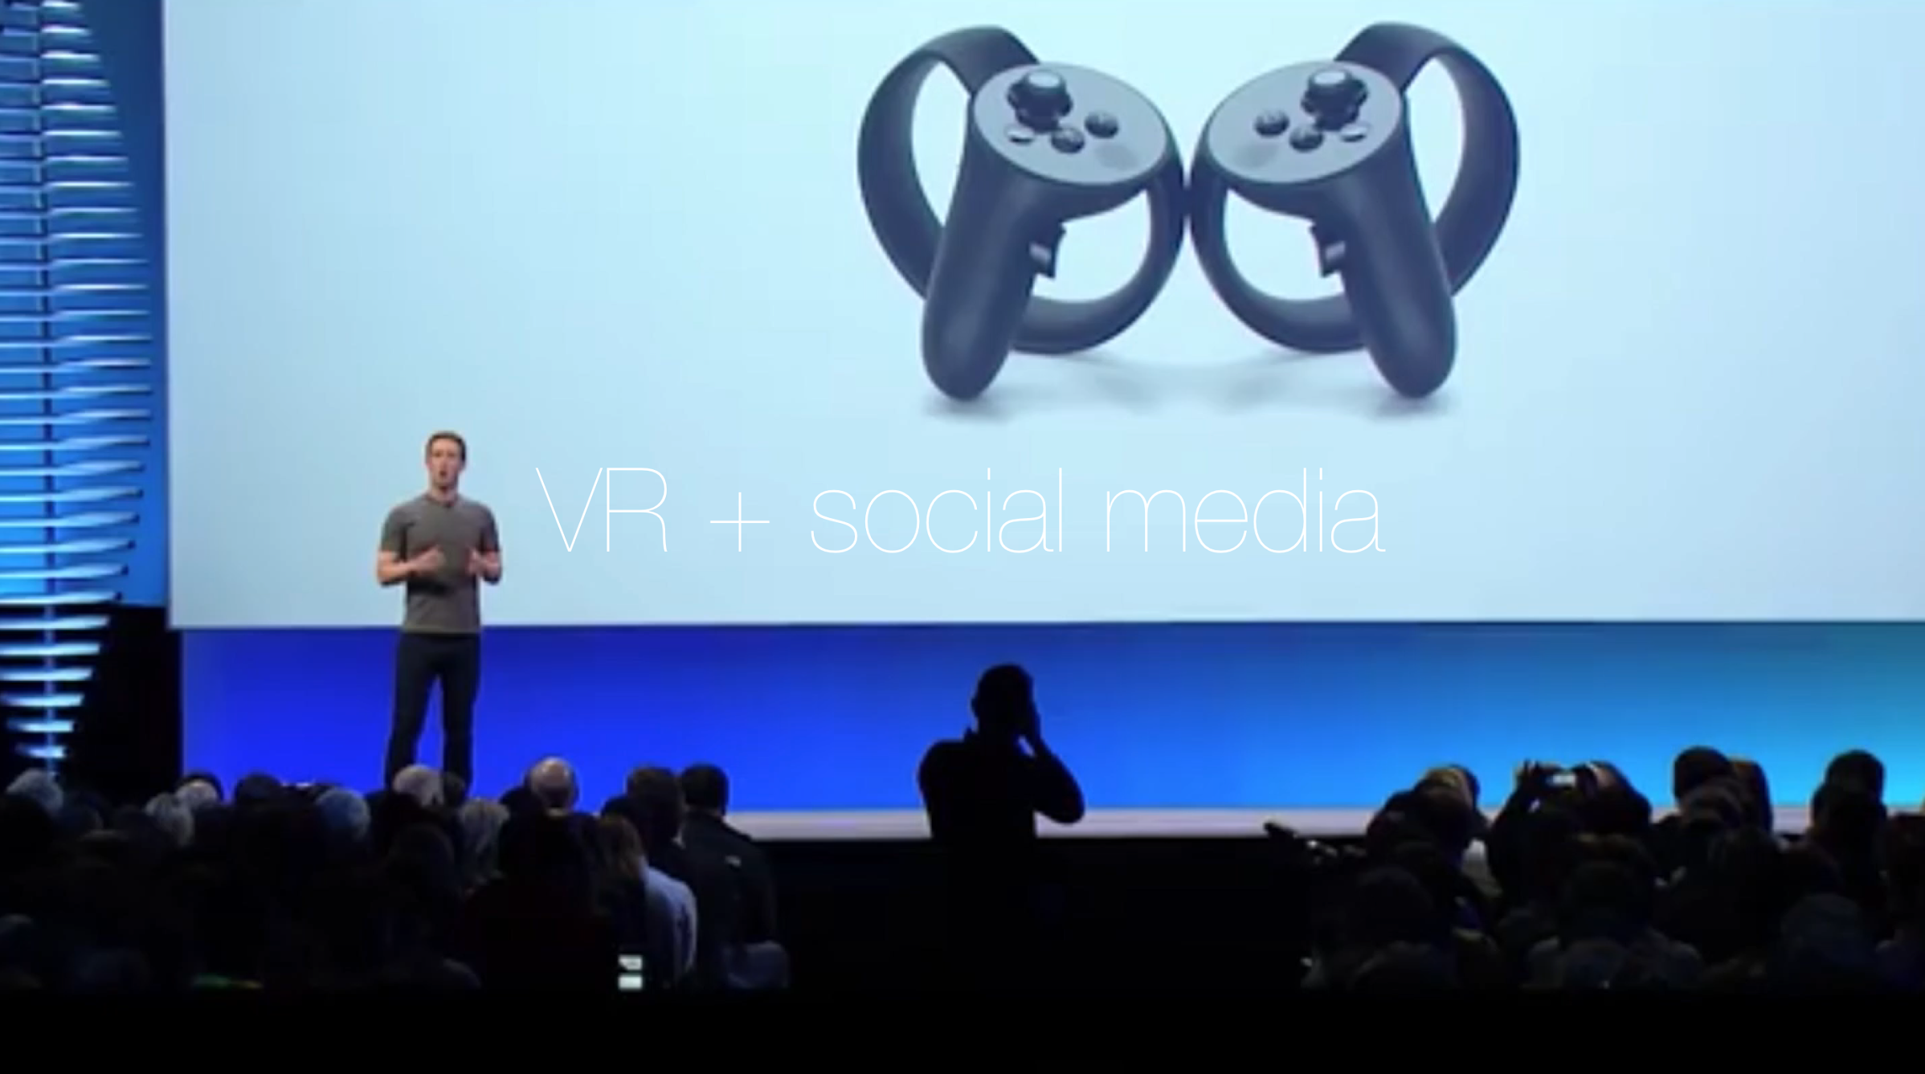
Intent statement
We would like to explore how people can use a virtual reality technology through social media in the future.
This is not just moments with their friends online, but entire experiences and adventures.
Our goal is to find what is humanizing VR experiences
in the context of social context.

Slide 5
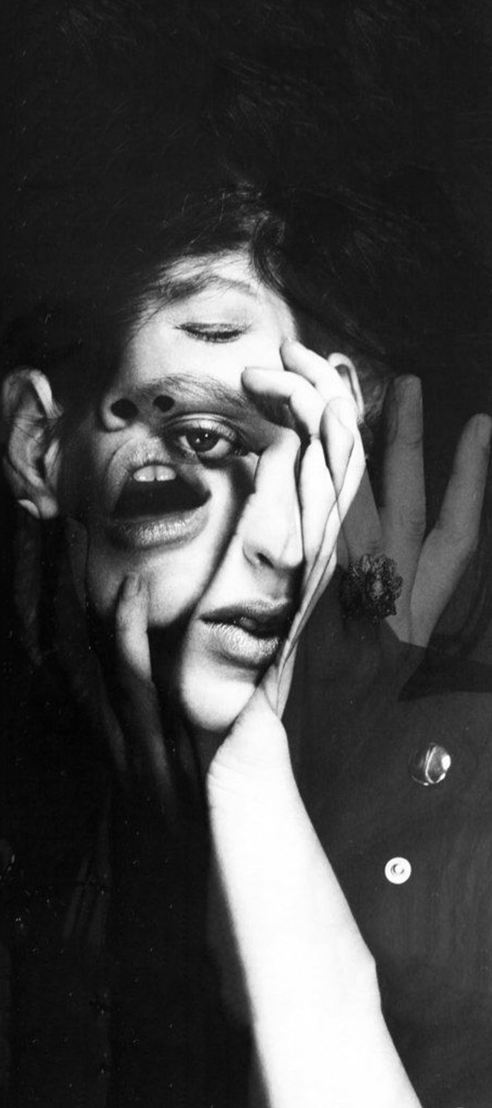



What we heard
“I would prefer to do hug or gestures... in some situations (a loss of their family).”
“I sometimes make a call about someone's post.”
“I want to explain more detailed stories by writing long articles with many photos.”
“I post some daily life experiences as a way of communicating with people who I rarely meet.”
“I use a hashtag, #, to find the person who might have same interests.”
“FB is for friends and family, not for the public.”
“I would post some photos in a invisible way, or in my own group chatting.”
“ I prefer multifunctional platforms because I can easily categorize things.”
“I want to talk with my friends through a Facetime video while having a meal because I feel more become close to my friends.”
“Mostly, I use a phone to talk with my parents about their news but, when we need to make an important decision for our family, we tried to connect to all family members. It feels like a talking with my family in the living room.”

Slide 6
Users’ needs
I want to feel emotion and feelings from others on social media.
I want to build strong relationships even we are far from each other and don’t know before.
I want to integrate my memories and control privacy on the platform.
I want to facilitate my conversation by using either activities or environment.

Slide 7
Design principles for facebook
Current facebook platform
Future Facebook with VR
Get reactions from others after posting pictures/video by comments
Keep your memories and share them at the same time
Broadcast your thoughts to others
Intimidate reactions from others after posting on Facebook VR
Customized sorting your memories and sharing them with specific people
One on one interaction

Slide 8

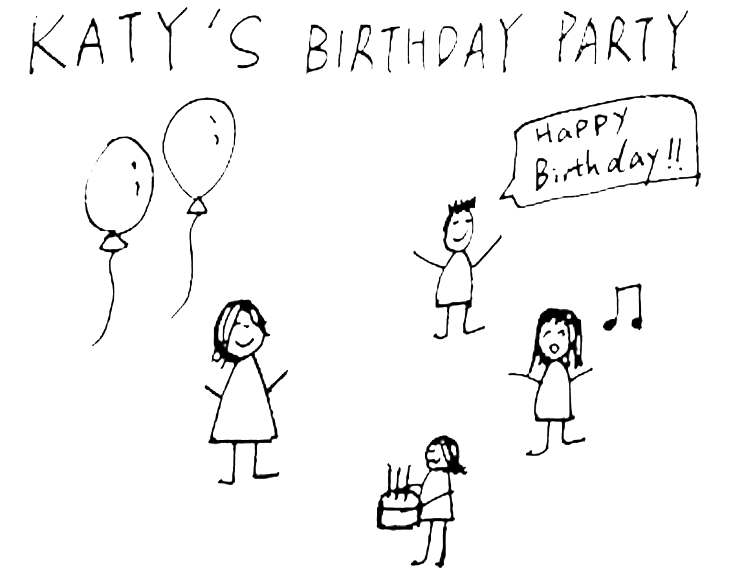

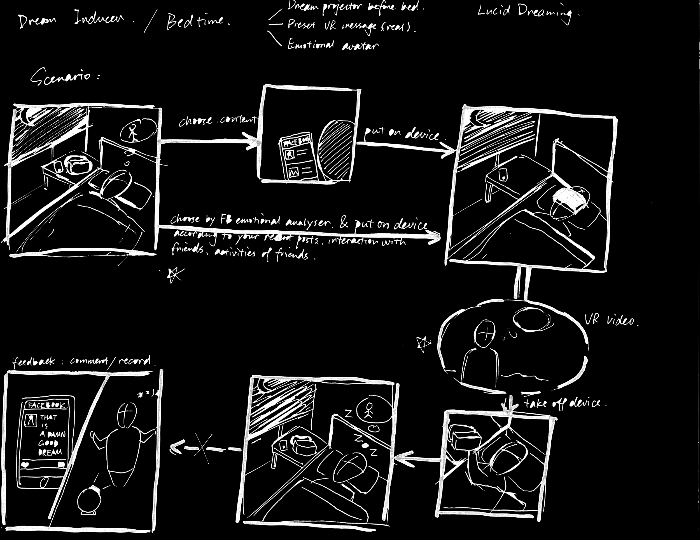
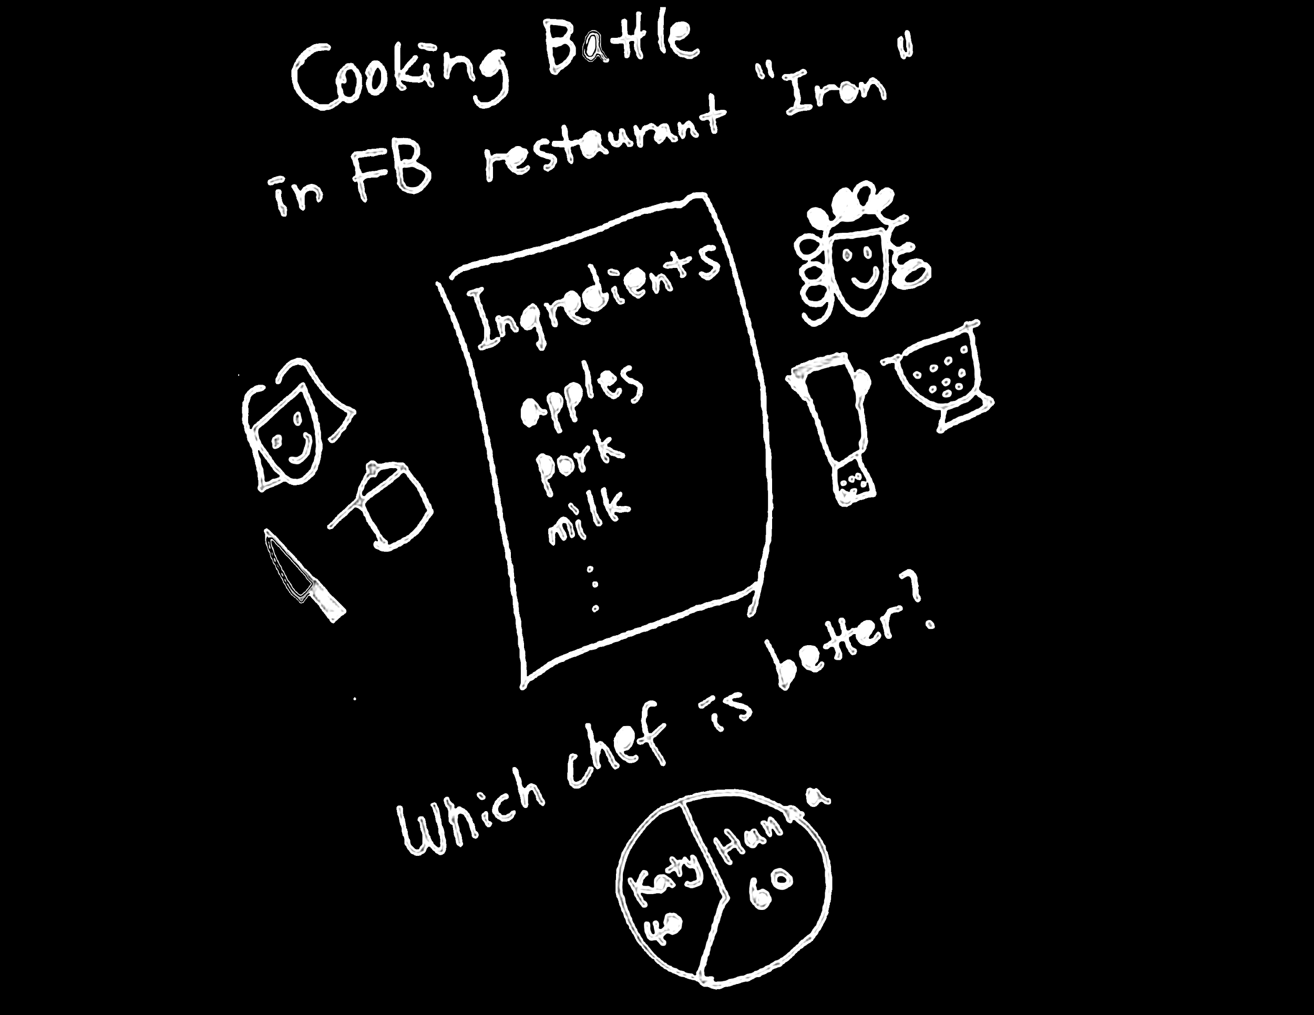
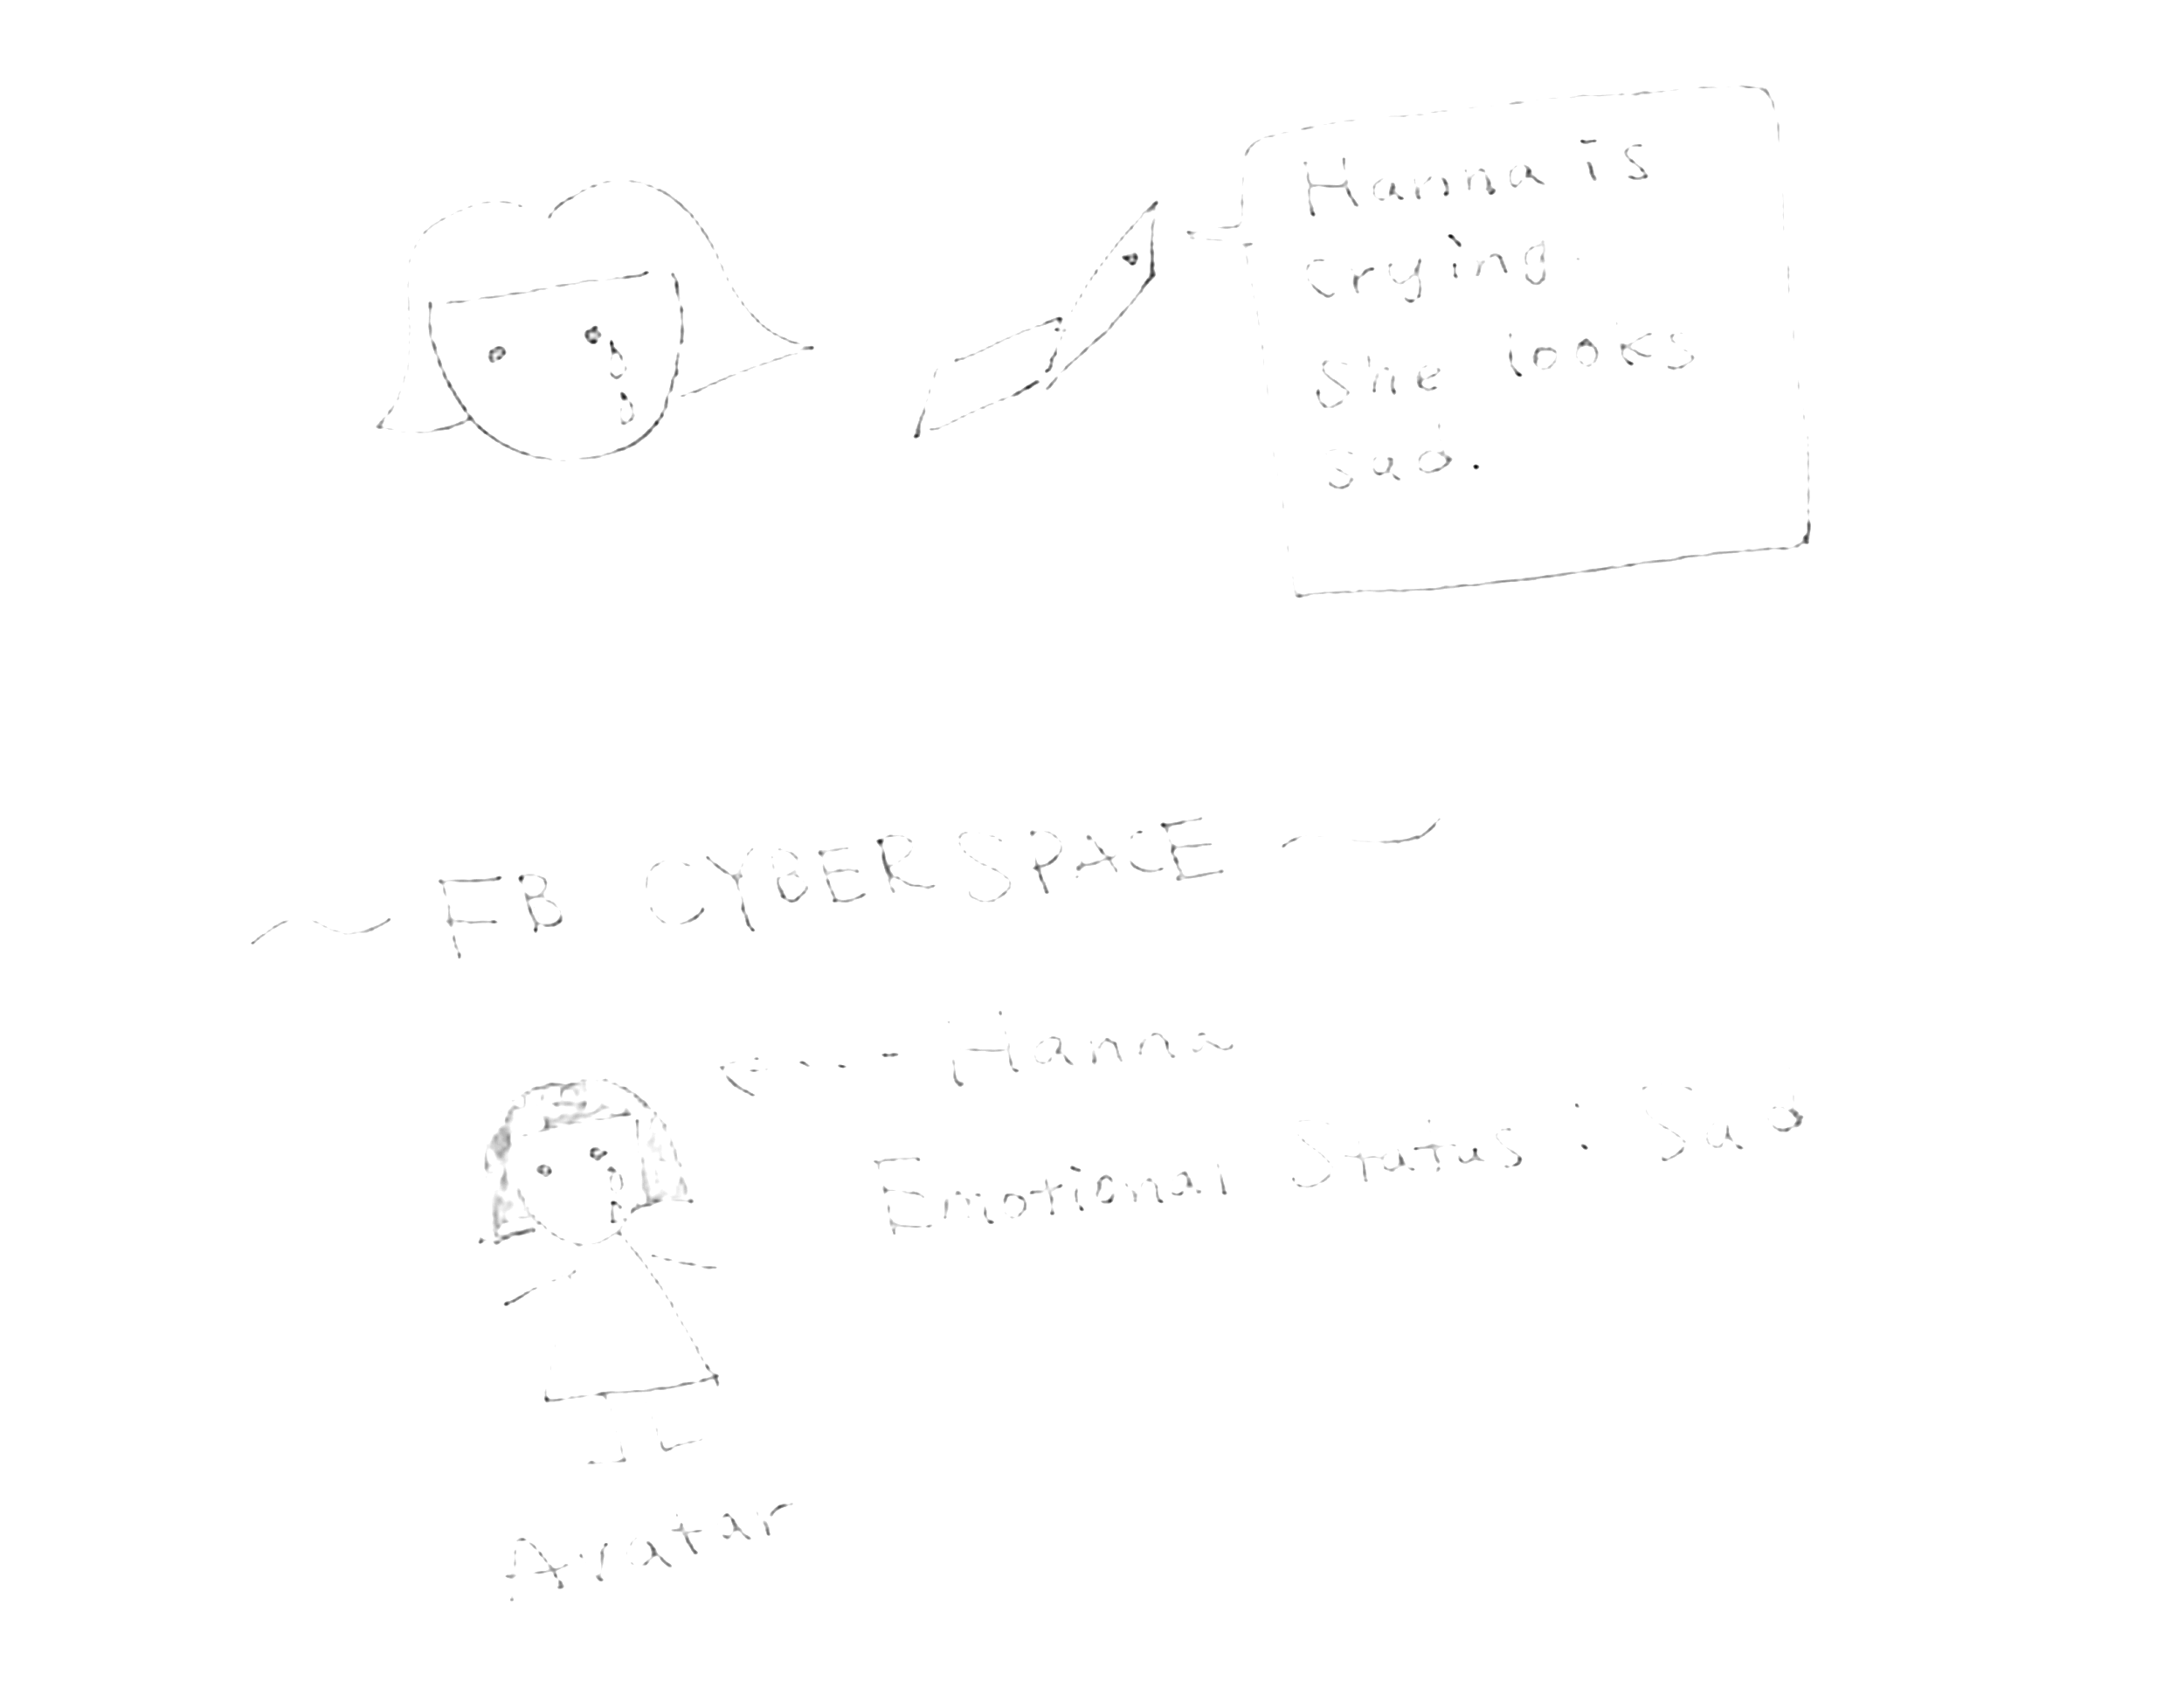
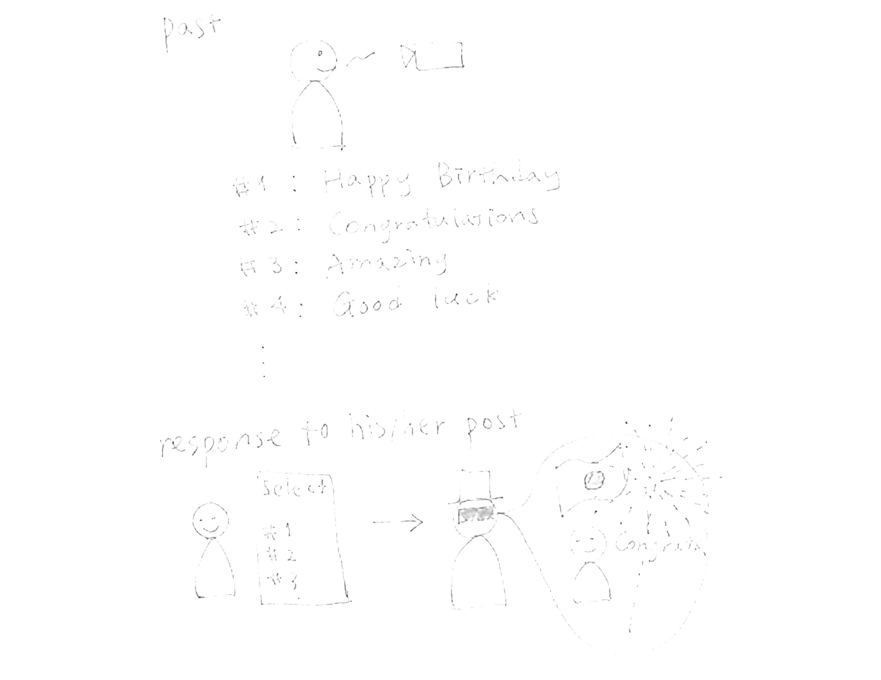
Concept 1 - Host events in virtual space
Concept 2 - VR Gallery
Concept 3 - Dream Inducer
Notes:
real time communication with friends who live far away

Slide 9

CONCEPT 1 - Host events in virtual space
Problem
What is the concept?
Jingwen edited on Dec 2
People live far away from each other can hardly feel others’ emotion and feeling.
Users can host real-time events in VR space with friends or pre-set their message to send. People can have fun in VR space even they can not meet.
http://www.aninakuhinja.si/wp-content/uploads/2016/10/Party-drinks.jpg

Slide 10
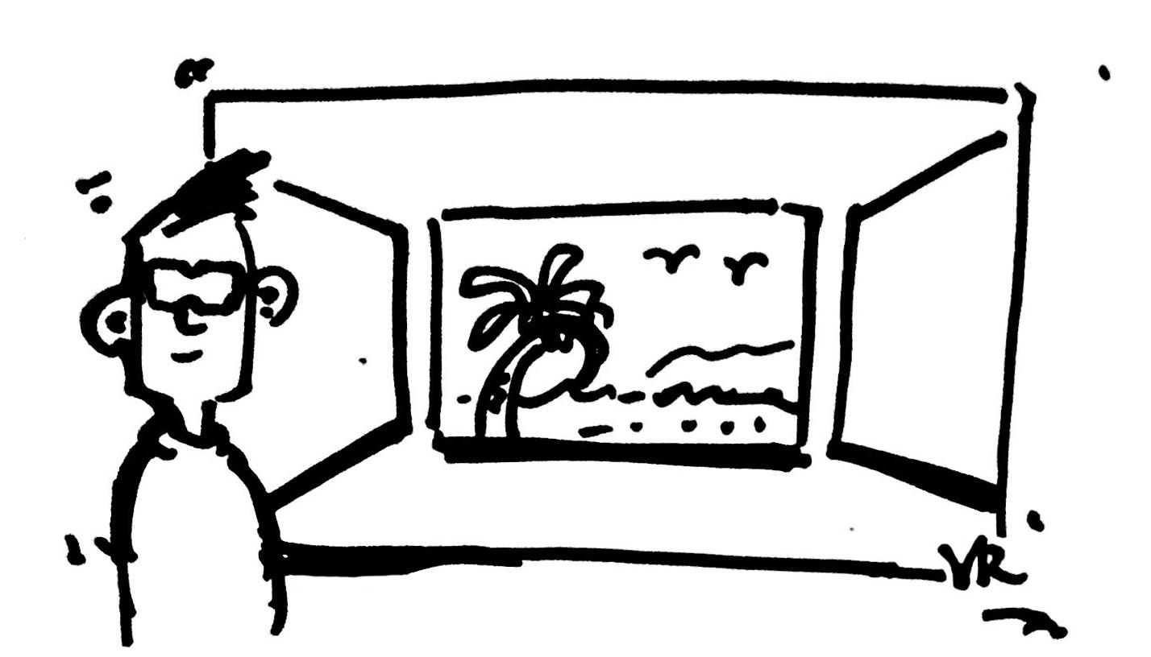
CONCEPT 1 - Host events in virtual space
Jingwen edited on Dec 2
ORGANIZER: SET UP
Peter’s Birthday Party
1. Peter uses facebook to set up a virtual space to hold his birthday party.
2. Preset scenarios and props are provided for him to customize the space.

Slide 11

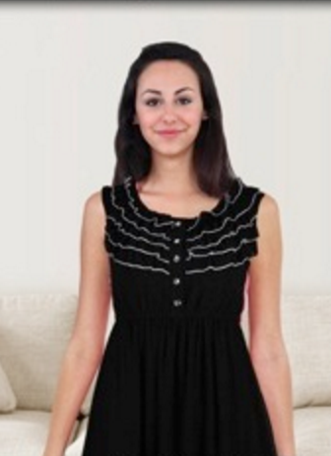
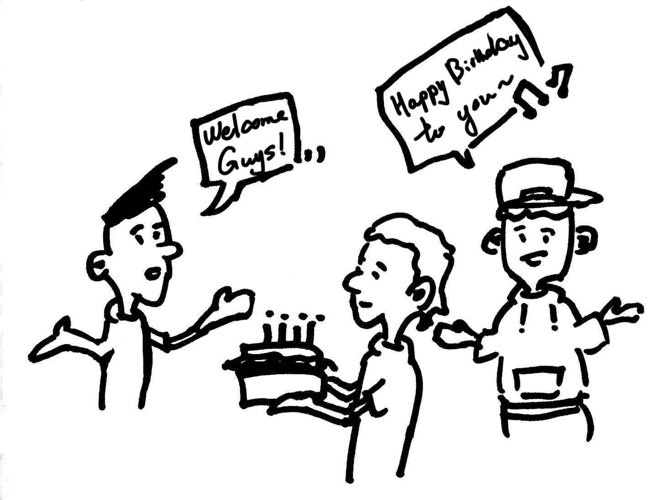
CONCEPT 1 - Host events in virtual space
Jingwen edited on Dec 2
FRIENDS: JOIN
RECORD THE EVENT
VR SPACE
7. Peter records the 360 video as memory in facebook.
Real (Video preset)
Half real/half avatar
Avatar (Real time)
3. His facebook friends join the party by avatar and celebrate.
4. Friends that can not join in time can send preset audio/video messages.
5. Friends can send virtual hugs, gifts and emojis.
6. They can enjoy a great time playing games together.
http://www.phonearena.com/news/How-to-record-screen-video-on-Android-5.0-Lollipop-no-root-required_id62678. http://zugara.com/virtual-dressing-room-technology/webcam-social-shopper#prettyPhoto

Slide 12
CONCEPT 1 - Host events in virtual space
User’s values
Jingwen edited on Dec 2
Users can keep in touch/have fun with friends even if they are far away from each other.
It is more engaging and users can enjoy richer interaction compared to video calls.
http://www.aninakuhinja.si/wp-content/uploads/2016/10/Party-drinks.jpg

Slide 13
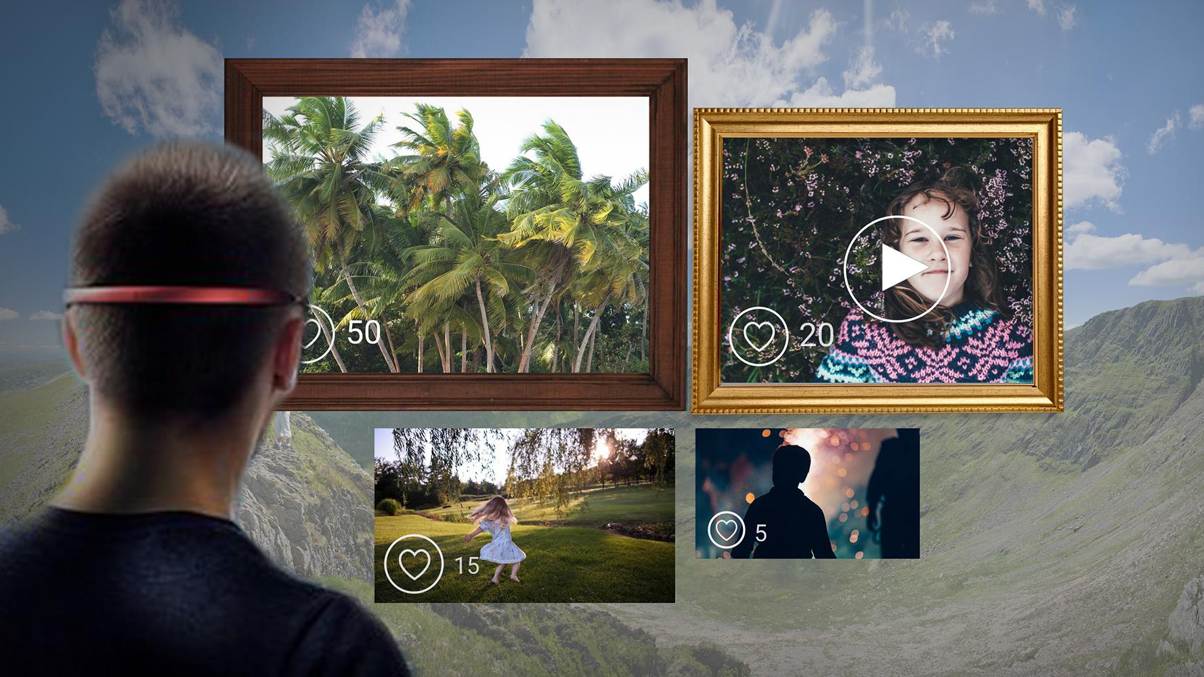
CONCEPT 2 - VR Gallery
Problem
What is the concept?
To control a privacy issue to share their pictures with others on Facebook platform.
Users can exhibit their pictures or video’s on VR space with some people who got a permission from the host.

Slide 14

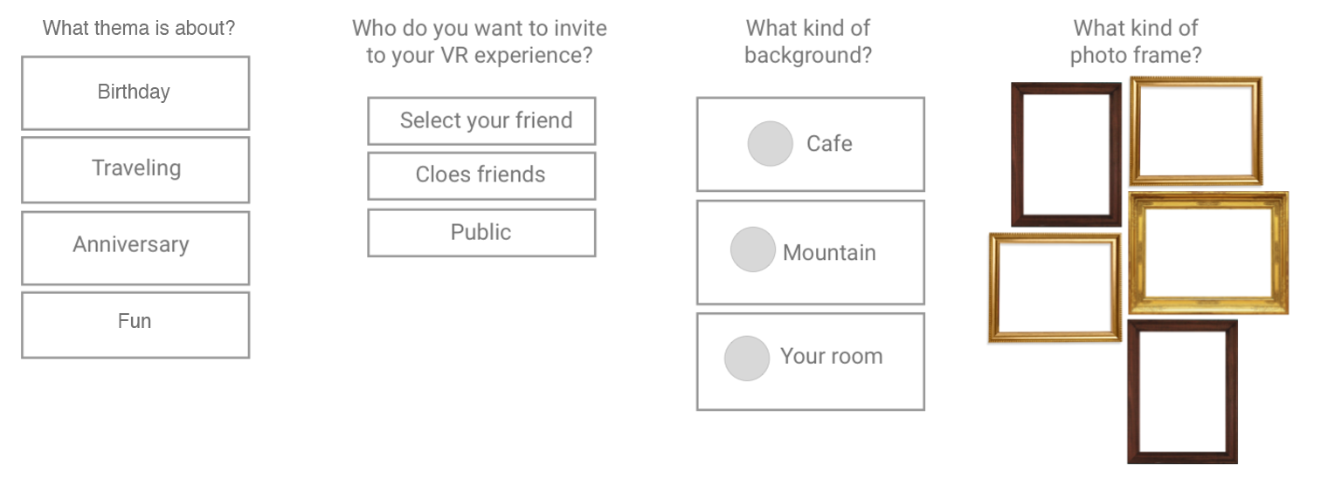
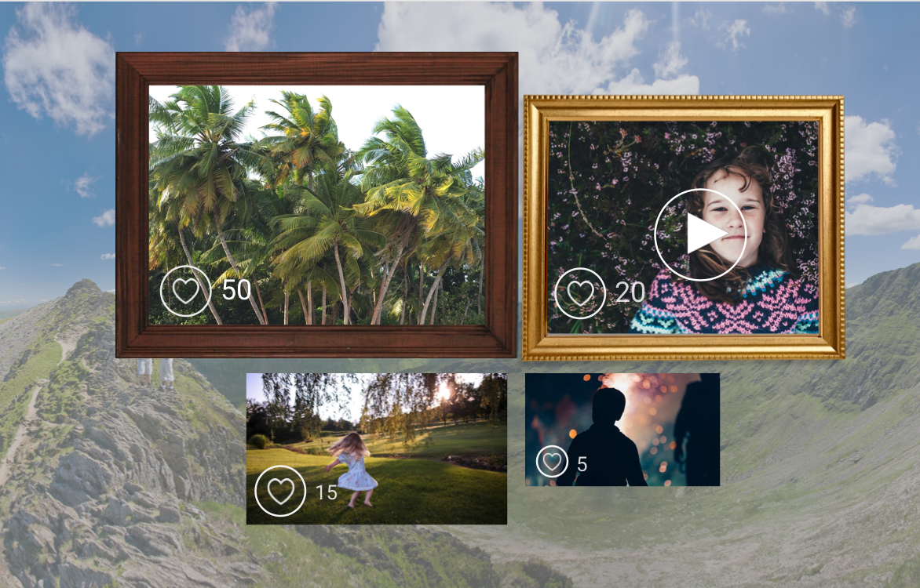
VR Gallery Scenario
1. Users get an invitation of Facebook VR from their friends.
2. They choose thema for exhibiting pictures, set up who they want to invite to the vr space, and how they want to sort these pictures by a system. They can also choose the background of VR space and photo frame of it.
3. (Social engagement) The size of pictures would be bigger depending on how many thumbs-up or reactions the picture would get from others and it could be smaller as well because it would get a low number of reactions from others.

Slide 15
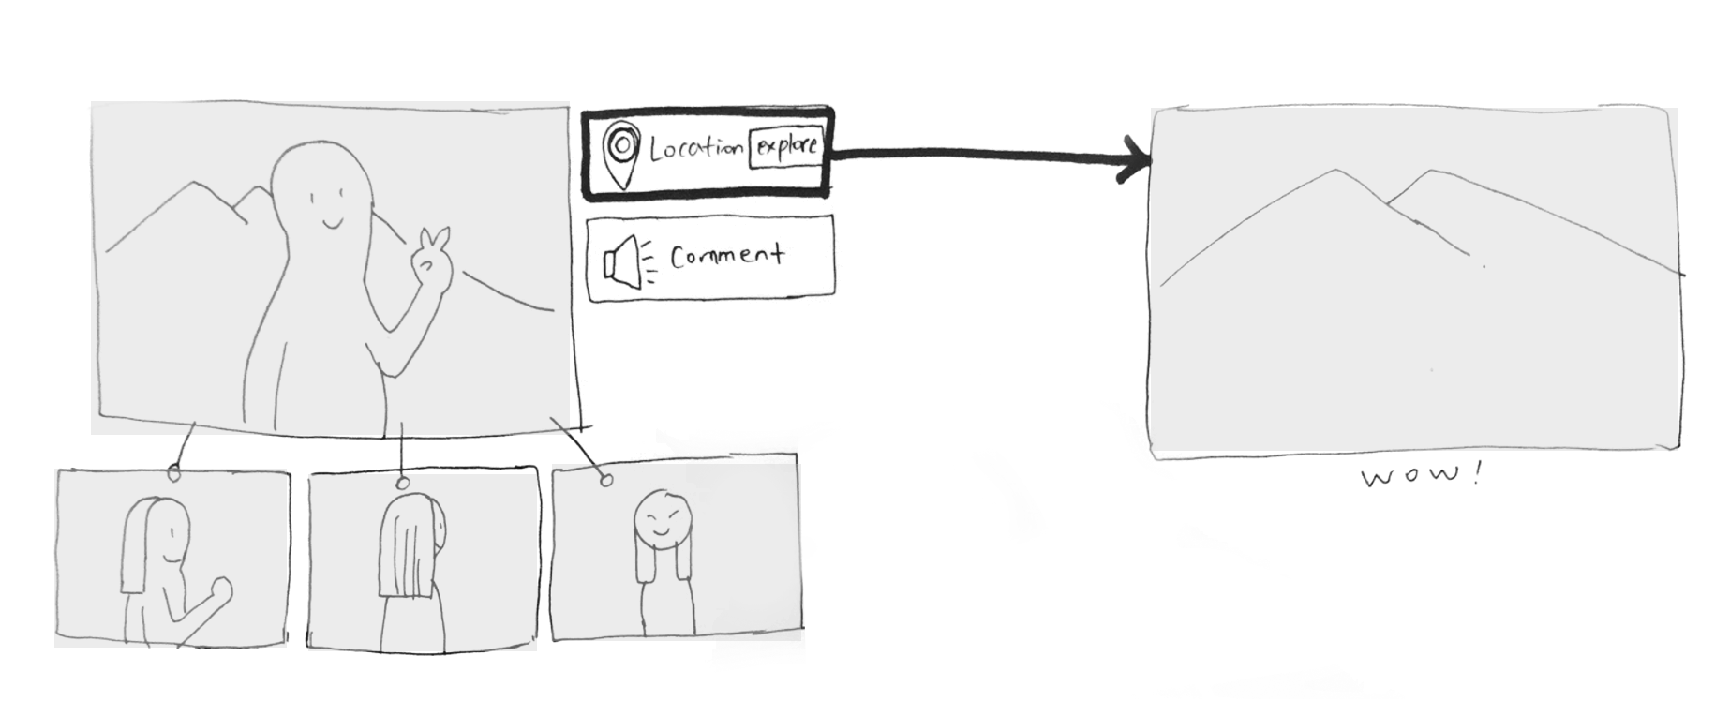
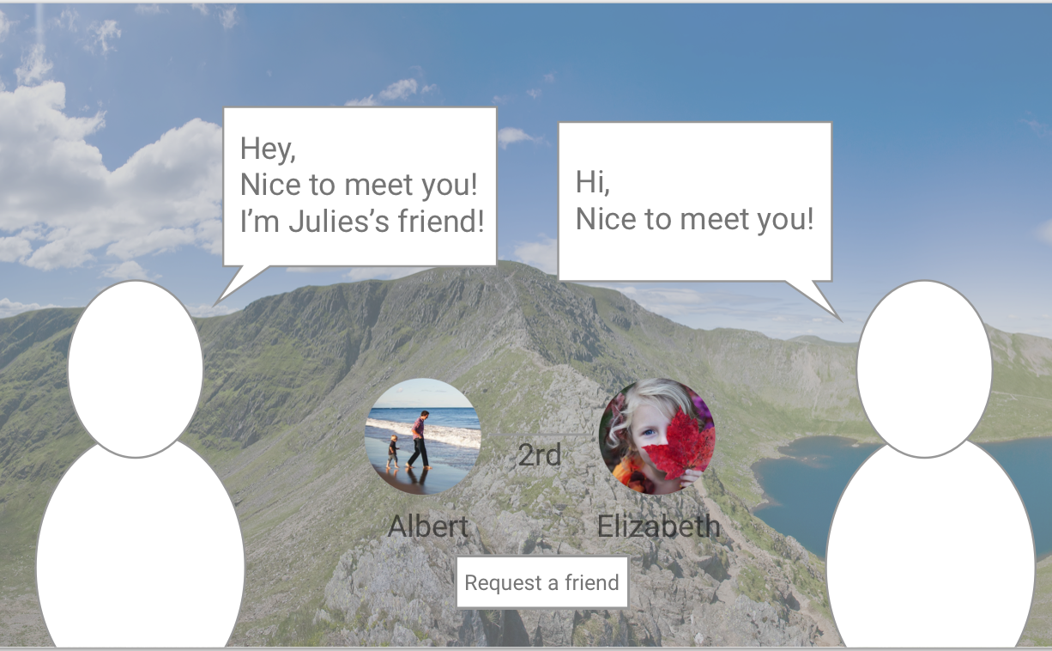
VR Gallery Scenario
4-1. They can see other pictures related to the picture that their friends linked in different perspective views of pictures.
4-2. Their friends can make a comment by recording their voice.
5. The users can also explore the location of the background of picture at 360 views..
6. (new social interaction in VR space)If there is another user who would get invited from the host on VR space, Both of them can see each other and talk there, while enjoying pictures.

Slide 16
CONCEPT 2 - VR Gallery
User’s values
Users can keep the data in a more flexible way.
Users can keep their memories/pictures in different perspective views.
Users can expand their network while enjoying contents in VR space.

Slide 17
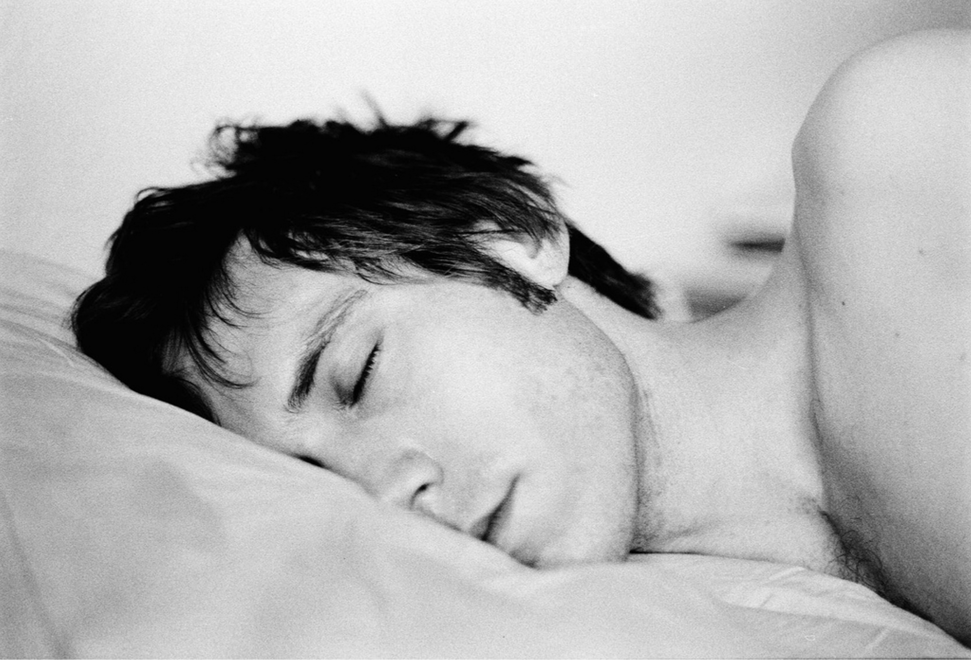
CONCEPT 3 - Dream Inducer
Problem
What is the concept?
Conversations and bonds between people and social platforms is week and should be facilitated with other approaches.
Before bedtime, users can enjoy VR video recommended according to the analysis of user’s emotion, which would induce users to have related dream that night and enhance the connection between users and surroundings.

Slide 18





CONCEPT 3 - Dream Inducer
Facebook
Account
Sweet Dream
Content Provider
Facebook
Third party studio
Self-record
INDUCE
ACCESS
Enjoy the Video
Facebook
Emotional Analyzer
SUPPORT
Content
Personal profile
Recent posts
Interactions
Friends activities
Album
Contacts
Activities (you really enjoyed last week)
Places (you always dreamed to go)
Mood booster
Greetings (recorded by your loved ones)
DISPLAY
VR Devices
DETERMINE
SUPPLEMENT

Slide 19
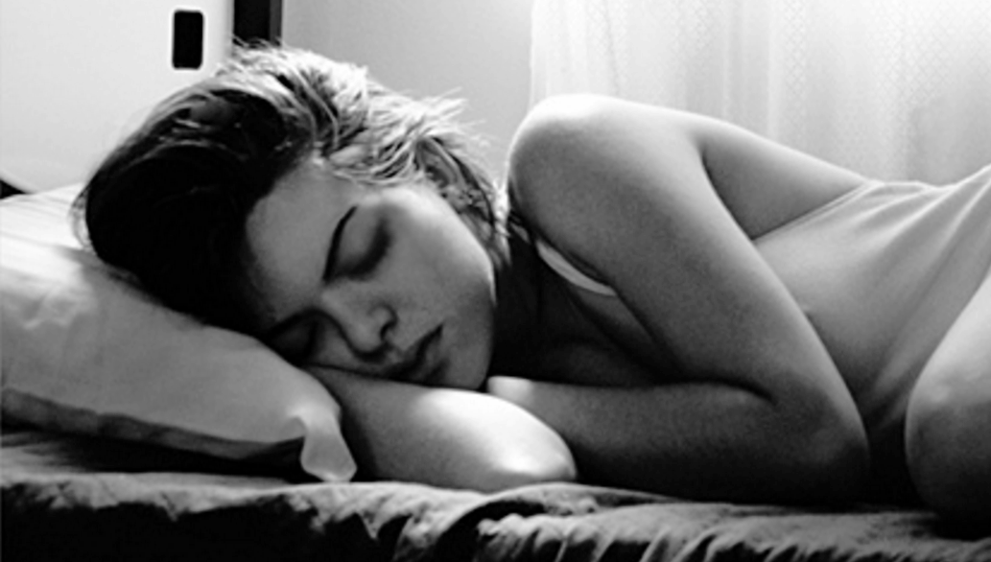
CONCEPT 3 - Dream Inducer
User’s values
Users could date back their memories through VR video before bedtime
Stronger connections with memorable friends and events.
Better sleeping experience with sweet dream induced by the device

Slide 20
Business values for Facebook
These three concepts have business values for Facebook as below.
Host events and VR gallery are both technologically feasible and enhance Facebook's business. On the other hand, Dream Inducer needs technical development. Facebook might charge this service in case the contents are provided from third party.
 | Host events | VR gallery | Dream Inducer
Technological feasibility | 3D environment half real/half avatar | Google cardboard controller | Emotion analyzer
Revenue possibility | Increase average time spent on Facebook and bring more ads | Increase average time spent on Facebook and bring more ads | Charge users for better service
Strategic fits with Facebook goals | Bring engaging environment | Offer the way of creating richer contents to users | Explore the opportunity to offer more intuitive, personalized contents, stronger bonds with users

Slide 21
Appendix
Trend Matrix Social Media From...to Exploration New Features on a Social Media Eras Map Value Web Research Participant Map User Observation Database User Interview Main Insights
22 23 24 25 26 29 30 32 34
Design Principles Facebook Platform Structure Design Context ERAF Map Workshop Ideas from Workshop First Draft of Our Ideas Drawings Solution Evaluation
35 36 37 38 39 44 45 46 53

Slide 22
Trend matrix: Sharing information & experience
 | Formerly | Currently | Emerging
Technology | Camera Letter Texting Book Fax | Visualization VR/AR Social media (Facebook,Twitter,Instagram) Skype/ FaceTime 3D printer data | Emotional Connection, Feeling VR + accessories(360 cameras) Sensors (Sound, Smell, Taste, Touch)
Business | Mail system Publishers (Book, magazine) | Online platform (not physical, only data) From one-to-one communication to share contents with the world
People | Mainly with Family & Close Friends Cost Time consuming | People who have a loose connection Globally Filtration/curation | Personal business Professional
Culture | Bad Accessibility Same/Close Special Occasion | Better Accessibility Open/Broad Daily life | Private/public
Policy |  | No illegal contents Ad restriction Prohibition in certain situations e.g. google glass (driving a car, bicycle)

Slide 23
Social media From..to exploration
 | From | To
People | Individual | Social
Boundary | Limited access of people | Bring people together e.g. facebook, give everyone the power to share anything with anyone.
What people want to share | Traveling (Location, View) Food Thoughts Sports activity e.g. Skydiving People’s pictures (selfies ,friends, family) | Protect a user’s privacy (e.g. snapchat's memories, Instagram stories) More various ways of communicating (emotions, weather, Body status)
What people don’t want to share | With Whom? (Boss, parents, partners) What? (e.g. family, small parties) Why? (Security, different friend circles, different degree of familiarity) | Permit/block some people Care about their online image (e.g. no like it, no comment)
Reactions | Like it Share- #hashtag, @id Comments(text-based, gif, video) Personal messages Emoji Comments by voice, gif, video | More become various to express people’s feeling

Slide 24
New features on a social media
Snapchat | Memories Memories is a new way to save Snaps and Stories on Snapchat. It’s a personal collection of your favorite moments that lives below the Camera screen. It is easy to move Snaps and Stories to My Eyes Only and avoid awkward moments when a friend stumbles upon a Snap meant just for you. It allows people to save a personal collection of moments as well as a provide privacy. | On-Demand Geofilters On-Demand Geofilters let you create and publish a Geofilter for your party, wedding, business, or any other place or event. You can buy On-Demand Geofilters for an event or even an entire block Community Geofilters are initially designed for public places. Here on-demand geofilters are for business or private event. | Story Explorer When you see a moment that inspires or excites you, simply swipe up to see more Snaps of that same moment - from every perspective. It makes possible to see diverse perspectives of the same moment. (diversity, better experience)
Instagram |  | Instagram stories As you share multiple photos and videos, they appear together in a slideshow format: your story. You can bring your story to life in new ways with text and drawing tools. The photos and videos will disappear after 24 hours and won’t appear on your profile grid or in feed. Unlike regular posts, there are no likes or public comments. People can post pictures as much as they want without overposting. Also, it takes a consideration on privacy.
Facebook | 360 photos People can share more immersive views of their world. | 360 Video There are a number of publishers sharing new 360 videos on Facebook today, including Star Wars, Discovery, GoPro, LeBron James & Uninterrupted, NBC’s Saturday Night Live, and VICE.
Facebook messenger | Instant Video Share real-time video with friends who aren’t right by your side or making your conversations richer by seeing each other face-to-face when you are messaging. |  | Secret conversation You can also choose to set a timer to control the length of time each message you send remains visible within the conversation.

Slide 25
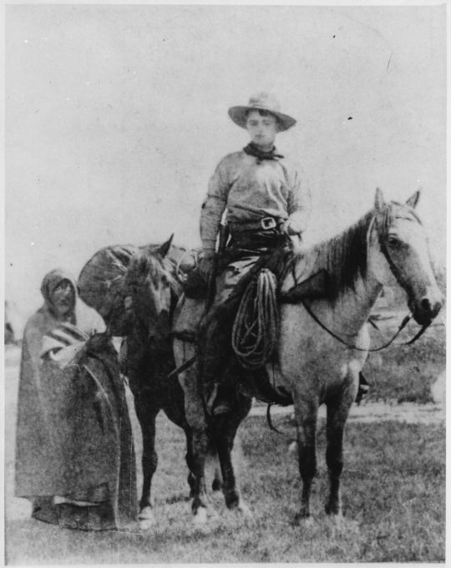
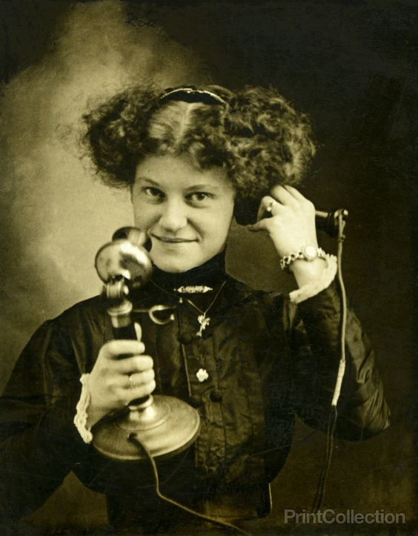
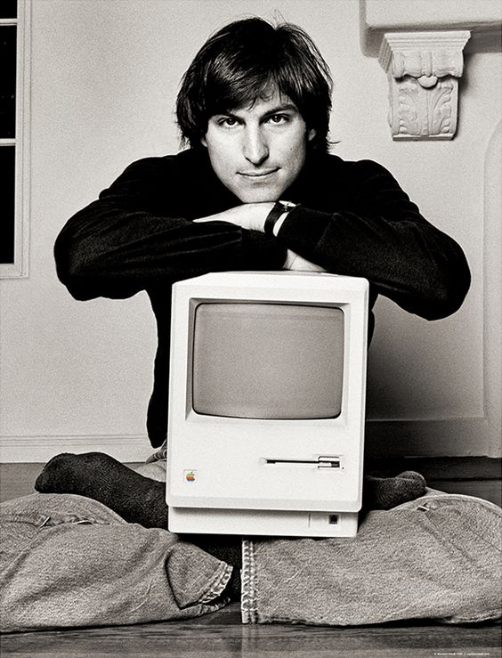
Chieko edited on Dec 2
Eras Map
 | Era 1 Physical Media | Era 2 Tele Era | Era 3 Internet Boost | Era 4 Social Network
Birth years | -1899 | 1900-1989 | 1990-2005 | 2006-2016
Medium | Mail, Telegraph | Telegraph, Telephone, FAX | Email, Forum, Text, P2P, Blog | SNS, Microblog, Live video, IM
Time Consume | days | hours | minutes | seconds
Contents | words | words, voice | words, voice, pictures | very short words, voice, images, videos
Relationship | Strong ties, regionally | Strong ties, nationally | Strong ties, globally | Weak ties, globally
Lifestyle | A slow life without tech, for telling important information | A life with tech, communication as infrastructure | A life with internet, sending and accumulating a lot of information | Busy life filled with mobile devices, immediately sharing and erasing unimportant information about everyday life
Notes:
Human beings have explored the ways of long distance communication over centuries. Now many people use facebook as a platform of communication. We can send short text messages, images and videos immediately without any cost. As we can contact with people very easily and instantly, each bond becomes weaker.

Slide 26
Chieko edited on Dec 2
Google
Value Web
Camera Providers
Platforms
Photos, texts, a few of videos
Device
Facebook, Instagram etc.
Ricoh, GoPro etc.
Contents
$
Individuals
$
Head Mount Display
Providers
Device,
Knowhow
Contents
Providers
Device,
Heavy Contents
VR industry is not mature enough to analyze competitors-complementors map.
Instead of this, we made value map to understand the emerging industry as a whole. We can enjoy high-quality VR experience even now but there are problems that the contents are made by professionals, not by our family and friends and contents are basically visual and sound, not other senses.
Contents
Oculus, Samsung etc.
Electronic Arts, Square Enix etc.
Microsoft,Sony
Notes:
VR industry is not mature enough to analyze competitors-complementors map.
Instead of this, we made value map to understand the emerging industry as a whole.
We can enjoy high-quality VR experience even now but there are problems that the contents are made by professionals, not by our family and friends and contents are basically visual and sound, not other senses.
Electronic Arts: FIFA
Square Enix: FF

Slide 27
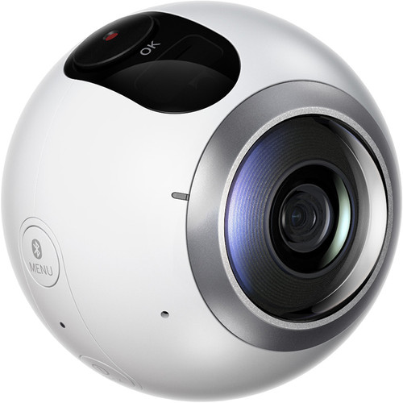
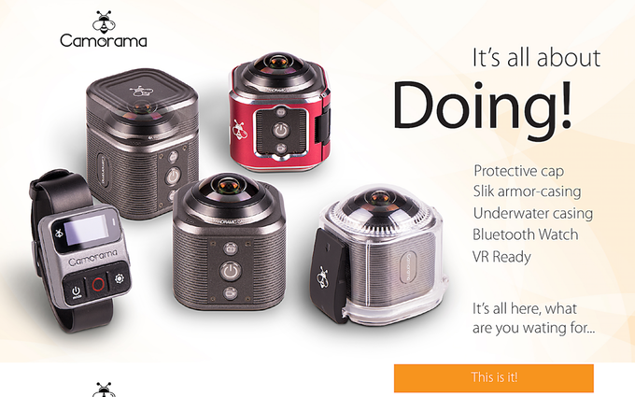
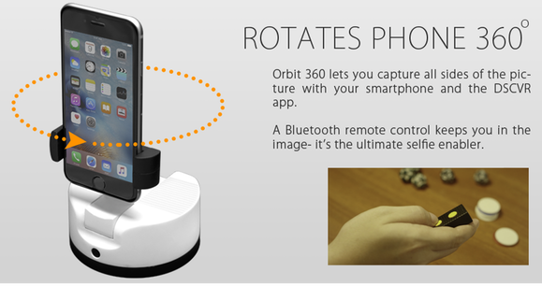
Chieko edited on Dec 2
Future Value Web 1: 360 and/or 3D videos
360 and/or 3D Camera Providers
Platforms
360 and/or 3D videos
360 and/or 3D cameras
Facebook, Instagram etc.
$
360 and/or 3D videos
Individuals
$
Device
Head Mount Display
Providers
Oculus, Samsung etc.
We explored the opportunities of future services by using this value web. Firstly, We changed from camera providers to 360 and/or 3D camera providers. If there is a 3D camera that we can easily record scenery, we can share our own experience on platforms.
Notes:
If there is a 3D camera that we can easily record scenery, we can share our own experience on platforms.
camerama: 360 action cam
orbit360: 360 turntable

Slide 28

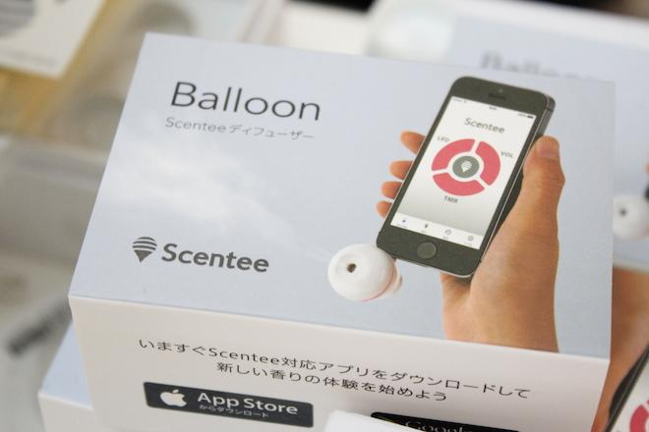
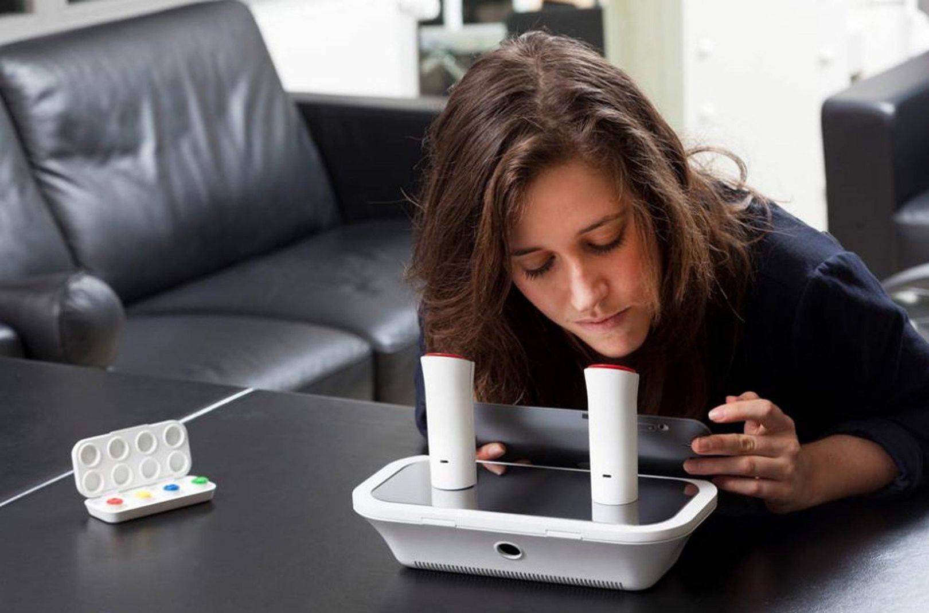
Chieko edited on Dec 2
Future Value Web 2: Sending Scented Messages
Camera Providers
Platforms
Photos, texts and smell instruction
Device
Facebook, Instagram etc.
Ricoh, GoPro etc.
Photos, texts
Smell instruction
$
Individuals
Smell Collection
$
Device, Smell
Smell Display
Providers
Secondly, we changed from head mount display providers to smell display providers. In Japan, there is a tradition to send letters with insense, Fumikoh. Now we can find several smell infusers controlled by smartphone. Though these are not common and have scarce variety of smells, smell seems a next frontier of sensing technology.
Notes:
In Japan, we have a tradition to send letters with insense, Fumikoh. We think that how about sending messages with scent?

Slide 29
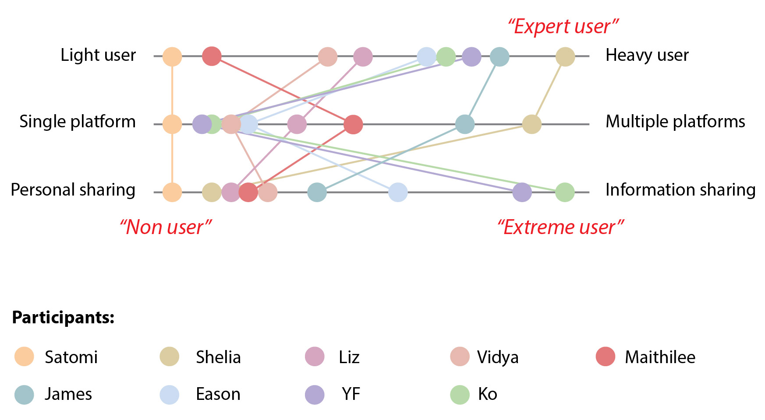
Jingwen edited on Dec 2
Research Participant Map
Our user research is done by interviewing 9 people and recording their posts. Participants include non user, expert user and extreme user. Research participants are mapped out in the map using three dimensions.

Slide 30
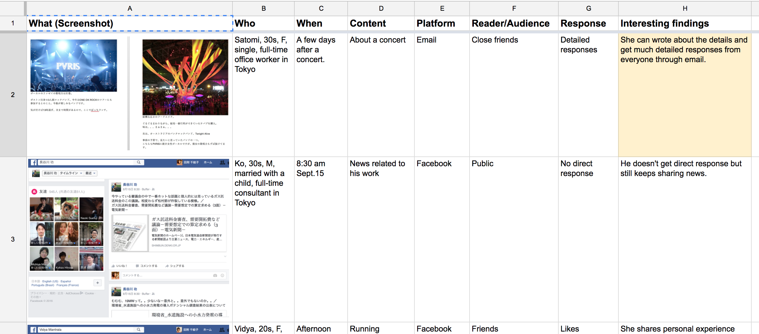
Jingwen edited on Dec 2
User observation database
To understand user’s behavior, we created a user observation database. Screenshots are used to record what users are posting in the social media. From these, there are some interesting findings.

Slide 31
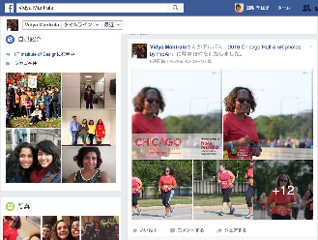
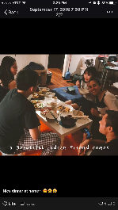
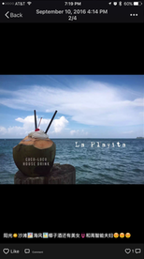
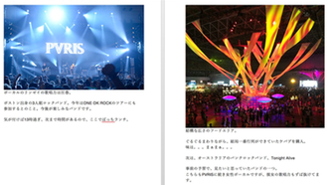
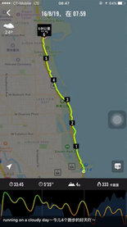
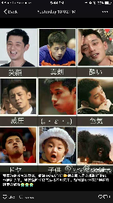
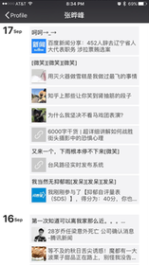
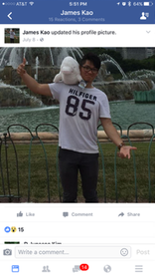
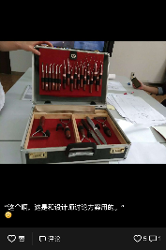
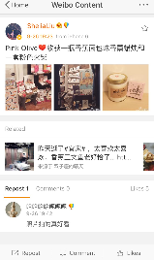
Jingwen edited on Dec 2
User observation database
These are the screenshots.

Slide 32
Jingwen edited on Dec 2
User interview
Following is our question list for the interview:
What is your hobby? / What do you usually do at spare time? How do you share your experience with others? Why/why not do you use these tools(platforms)? What’s your preference and why? What do you share?(with simple/long comments or not? why?) What kind of things do you share with friends/public? Why? Who are your readers(audience)? How do your readers reply?(likes, comments, personal messages?) Do you like this way? Why/why not? What may help? Are there any problems or bad experiences? How do you want to change your social media experience? What services/apps/technologies do you really want to use? Why?

Slide 33
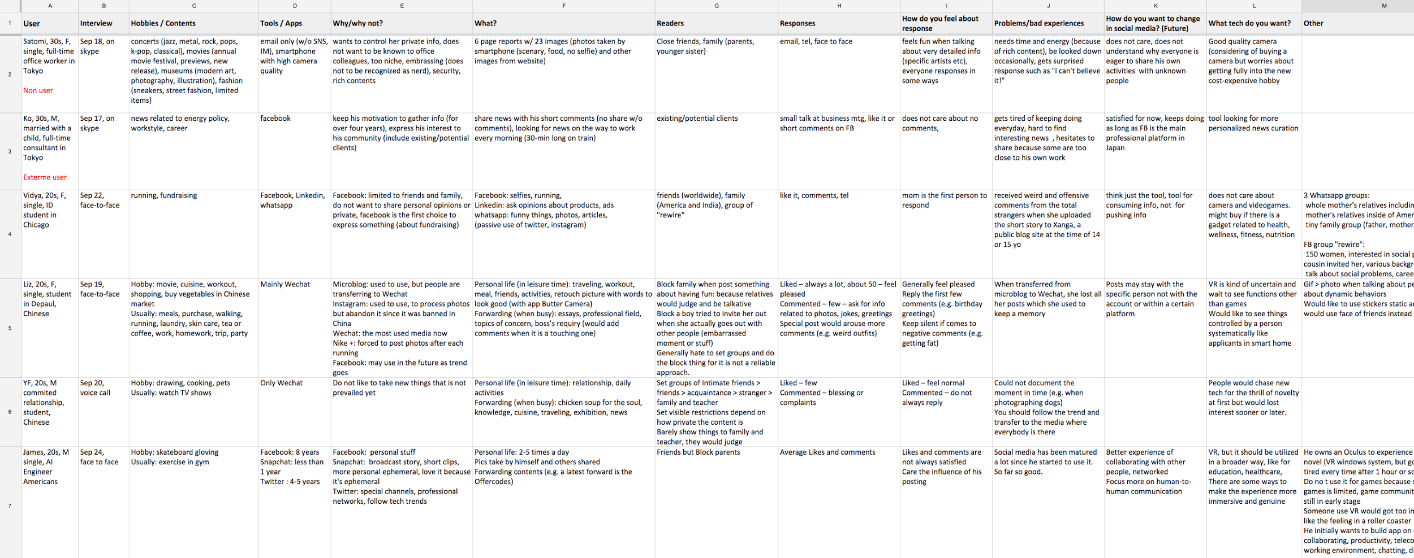
Jingwen edited on Dec 2
User interview

Slide 34
Jingwen edited on Dec 2
Main Insights
CATEGORY | INSIGHTS
Expecting responses | People expect a detailed response rather than just "like it"
 | People have anticipated audience and would like to interact with them every time
Public / Private | People sometimes enjoy personal chatting more than comments.
 | People feel happy when he can receive the response offline
Finding new friends | People use a social media as a tool to find interesting people.
 | Social media helps to make friends who have similar thoughts in different countries/areas
Building connections | People want to build a strong relationship/make a intimacy by sharing their private area or meals.
Keeping in touch | People want to keep in touch with friends by sharing experiences on a social media.
Storing memory | People want to store their moments on social media and show them with others offline to explain the situations.
 | People want to have a private area to keep their pictures.
Notes:
From the interviews, we was able to get several insights.

Slide 35
Design Principles
How might we help him to feel emotion and feelings from others on social media?
How might we facilitate their conversation by using either activities or environment?
How might we integrate her memories and control her privacy on the platform?
How might we help her to communicate and expand her network?
How might we help her to build strong relationships even they are far from each other and don’t know before?
Notes:
From these insights, we made five design principles. Based on these, we conducted the workshop and brainstorming session.

Slide 36
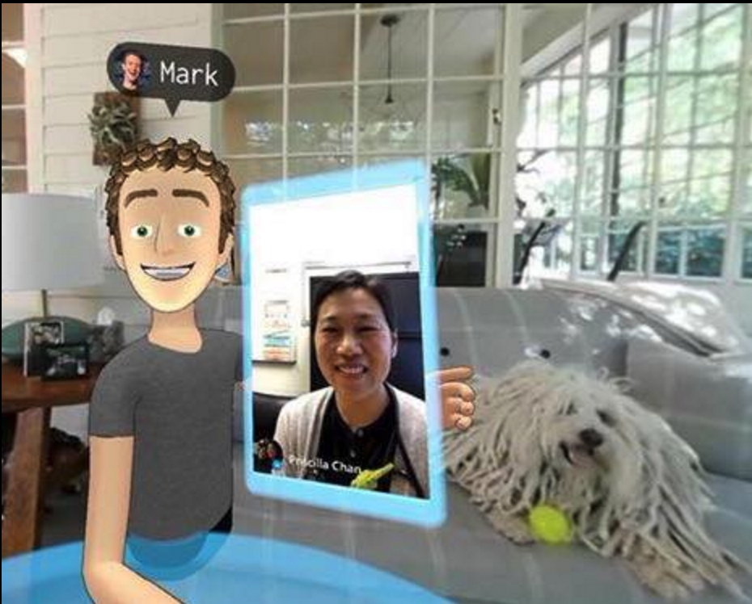
Facebook Platform Structure
Entry
1.
Laptop
Facebook newsfeed
Facebook Account
Mobile
Facebook 360
video platform
2.
Samsung Gear VR headset
360° video
app
Facebook VR space
Watch(03,16)
3.
Oculus Rift
Like, react, share without leaving VR (05,16)
Facebook messenger
4.
Oculus
Facebook
VR app
Touch

Slide 37
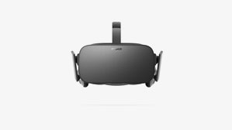
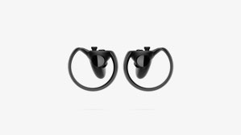
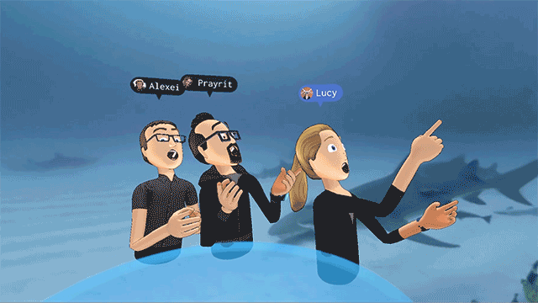
Design Context
Create content
Content
Use device
Based on platform
Get experience
Camera, cellphones
Facebook plug-ins
see
Virtual images
Public
3D photos
Cellphone
3D-360° video capture system
VR app
enjoy
Virtual environment
3D videos
Oculus headset
Touch motion controller
3D modeling
Avatar
interact
With Virtual people
Private

Slide 38
Chieko edited on Dec 2
ERAF Map
Sensor
head mount
display
3D camera
We made ERAF Map to capture current VR industry.
The most important finding from this diagram is that VR contents have a broad variety and most of them are not well developed.
We decided to create new ideas in regard to contents in further process.
facebook
Device
Platform
controller
connects
instagram
$
$
is offered to
is channeled to
provides contents
accesses
image
game
is offered to
$
share
Content
User
sound
video
enjoys, gives feedback to
receive
conference
conversation
is offered to
activity
avatar
experience
Relationship
old friends
chatting
sports
meal
new friends
travel

Slide 39
Workshop
We have done a brainstorm workshop based on four personas we conclude from previous research. We gather people into two groups and let people generate solutions and ideas for those four users.
Ken
Karolina
Teresa
Jessie
How do you respond more sincerely to deliver your feeling to others?
What do you want to do with your friends in virtual space(real time connection) to keep your close relationship?
(object, activity, environment)
How do you want to manage your data in a flexible way?
(offline, online storage-sharing, virtual space)
How do you expand your network and build strong relationship?

Slide 40



Person who seeks sincere response
1. Ken
I am an ID student from Japan. A few days ago I announced on facebook that I just engaged with my fiance! Many family members and friends who live in Japan posted text messages for celebrating us.
However, I cannot feel their heartfelt congratulations stronger than I hear their responses face-to-face or talk on the phone. Because there is 14-hour time difference between Chicago and Japan, telephone is not the option.
Notes:
1. Remove pain points that we cannot feel emotion and feelings from others.
Live far away from his finance, Time difference, Want to share what he did today, But, lack of feeling when they talk
Response(tech-human feeling-e.g. Facial expression, experience)

Slide 41
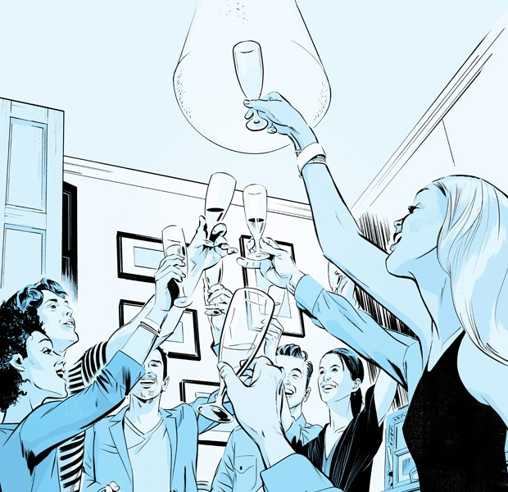
Person who eagers for real time connection with intimate friends
2. Karolina
I recently moved into Chicago from Germany. Most of friends are living abroad. We often made a schedule to talk about what you are doing.
At that time, I feel more close to my friend when I have meal with my friend while talking with her. Or sometimes, we talked about our memories seeing traveling pictures over the phone.
Just talking is not enough for me to keep in touch with my friends and become more close with them.
Notes:
International students, Real-time experience, space, virtual space?
who wants real time communication with friends who live far away
Who eagers for real time connection with intimate friends

Slide 42
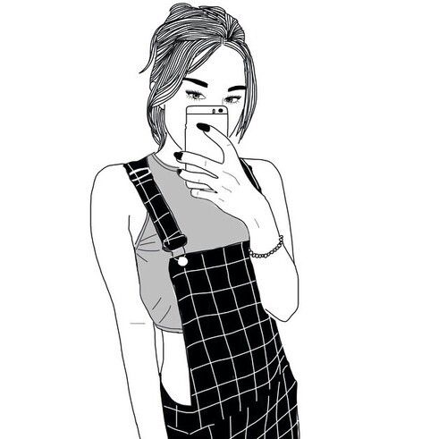
Person who keeps her memory on social media platforms
3. Teresa
I am a girl who post pics and words on social media nearly everyday. I am not a selfie psych, nor a social butterfly. I just like to keep records and share with friends on daily things which are memorable for me. Cuisines, parties, views, exercises. I really wanna make it like a diary which I would look back from time to time.
And by the way, I post different contents on different platforms. For example, FB is much more like a personal space for me than Twitter. Sometimes I would also set up visibility setting according to contents, which is kind of an extra work for me.

Slide 43

Person who is trying to find new friends with same interest
4. Jessie
I am a food lover from Chicago. I love cooking and bakery. I often post photos and videos on facebook and can only get a little feedback from my friends.
I would like to make new friends with people who share same interests even if they are far away. I would share the food I made, the cooking process, recipes even great restaurants or farmer’s market with them and join their cooking. I would also like to get their comments, thoughts and feelings about food, etc. Maybe next time I travel to somewhere else, we could hang out and enjoy food together.

Slide 44
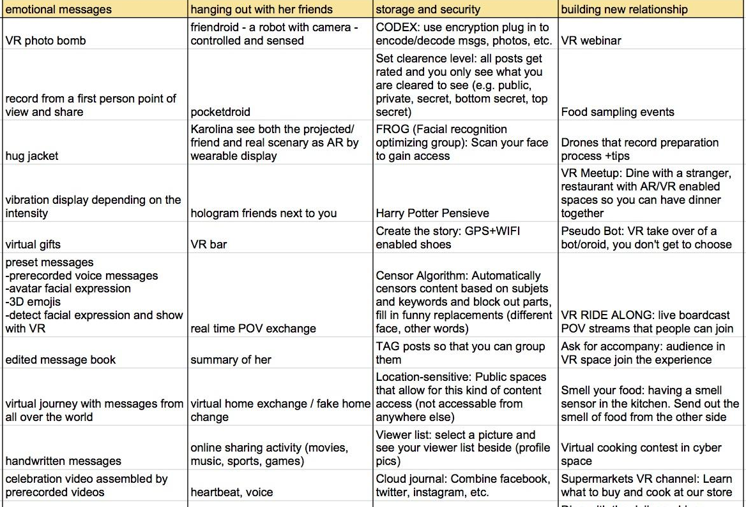
Chieko edited on Dec 2
Ideas from workshop
We collected over 50 ideas by facilitating the workshop.

Slide 45
Chieko edited on Dec 2
First draft of our ideas
We generated a dozen of ideas and drew them as simple illustrations.
Emotion | Conversation | Memory & Privacy | Relationship
Preset VR messages | Pocketdroid (VR gopro) | VR memory space (360 who) | VR meetup
Music | Heartbeat & facial expression detect | Face replacement | Send smell
Hug | VR selfie stick |  | VR Yelp
 | VR dress up

Slide 46
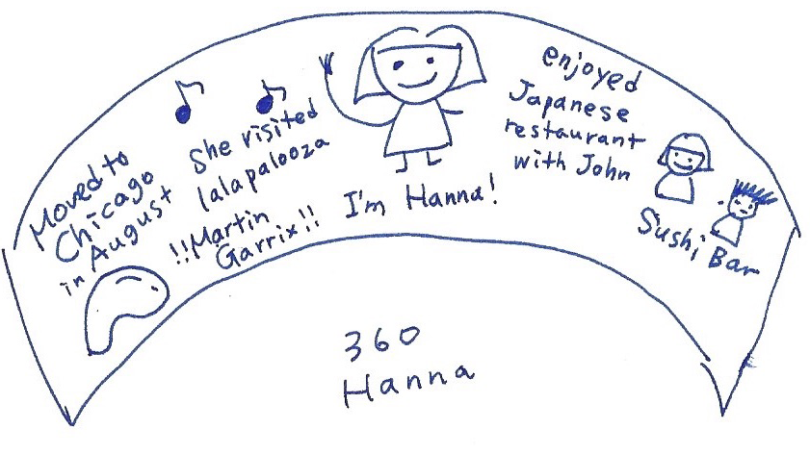

Celebrate party in virtual space
360 Who
Chieko edited on Dec 2
Drawings
Someone sets up a virtual space with a certain theme, such as birthday, wedding, etc. (Preset scenarios and props provided by the platform)
Friends join the party by avatar when they are free and celebrate.
The platform records the 360 video as memory.
Facebook automatically makes a brief 360 video that introduce person's profile, interests, activities and network based on his/her old posts and relationship.
People can see this video as a summary of him/her.
OR
People can use it as a 360 diary/blog and keep the memory.

Slide 47


Cooking battle in FB
Pocketdroid
Chieko edited on Dec 2
Drawings
FB organizes cooking battle events. Users can join both as challengers and audience.
Challengers cook their dishes in their own place with camera and mic. The audience enjoys watching their cooking by VR.
The audience vote which chef is better, make comments, etc.
There is a portable small robot who has a camera, a mic and a speaker.
People can see the scenery through the robot's camera and hear the sound through a mic.
In addition, they can remotely manipulate a camera and speak through a speaker.

Slide 48


Emotional Avatar
Preset VR messages
Chieko edited on Dec 2
Drawings
Record short-length 360 video messages beforehand. Typical messages are "happy birthday", "congratulations" and so on.
Send a preset message when it is needed. You can send these messages automatically if you want.
OR
Create your own Avatar and some motions. Send it to friend as soon as he/she posts something. Be in friend’s virtual space
Facebook detect his/her emotional state from facial expression and heartbeat.
His/her avatar changes the face to represent emotional state.
Friends know this and comfort him/her.

Slide 49


Instant Glee
Preset VR messages
Chieko edited on Dec 2
Drawings
Facebook automatically replace friends' face in images and videos to anonymous face icons to cover their identity.
Some people can see original images and videos depending on their security level. For example, people who were in images and videos can see the original ones.
People record singing the same song individually.
Facebook automatically combines these video clips into one 360 video.

Slide 50


Virtual Dress-up
Hug Place
Chieko edited on Dec 2
Drawings
Put on a glass and see people dressed up
Have a costume party more easily
Your avatar enters in "Hug House" in facebook cyberspace.
You shows your status and your avatar can hug with random avatars in the Hug House.

Slide 51


Selfie Glass
Scent Message
Chieko edited on Dec 2
Drawings
A glass that enables you to see virtual scenes and record your face at the same time
Have a virtual facetime with your friend and you could see each other’s face at the same time
Send the smell food and enjoy cooking together.
OR
Send the smell of flower with text, photos, videos.

Slide 52


Magic Plate
Virtual Hugger
Chieko edited on Dec 2
Drawings
Take on your VR glass and enjoy your virtual meal
Everything changes to virtual (scenario, companion) except the food you are eating in your plate.
A soft tile on the column for you to hug
A hole on the column and you could see VR scenes through it
Hug it and feel the warmth of your partner

Slide 53

Chieko edited on Dec 2
Solution Evaluation
We evaluated by two criteria: the user value and the business value. In the user value, we weighed social interaction, engaging experience and convenience in this order, while in the business value, we weighed technological feasibility, revenue opportunity, marketability and strategic fit with Facebook goals in this order.

